Slide 1
Python Control Flow – Looping (For and While)
By Radjamin Hukom

Slide 2
For loop
The for loop takes a collection of items and executes a block of code once for each item in the collection.
For (name of variable) in (a set of values):
(insert action)

Slide 3
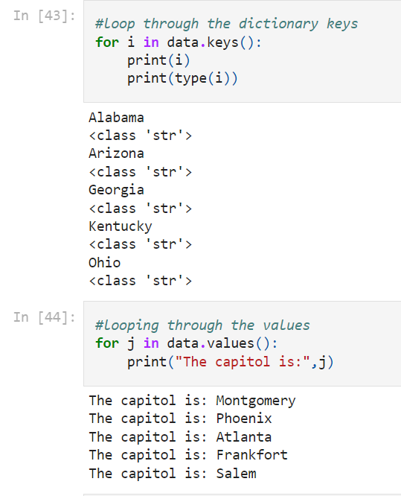
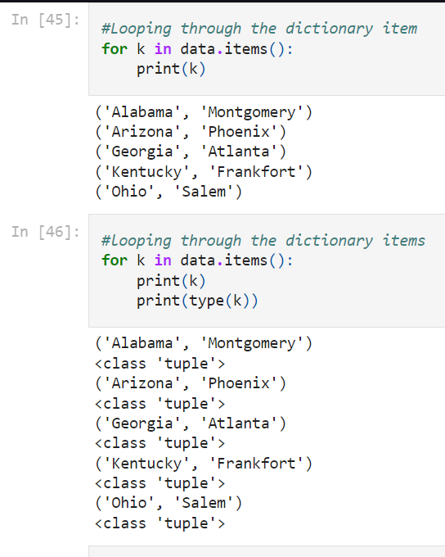
Examples of for loop

Slide 4
While loop
the while loop runs as long as, or while, a certain condition is true.
Can have A FLAG, acting as the signal to the program.

Slide 5
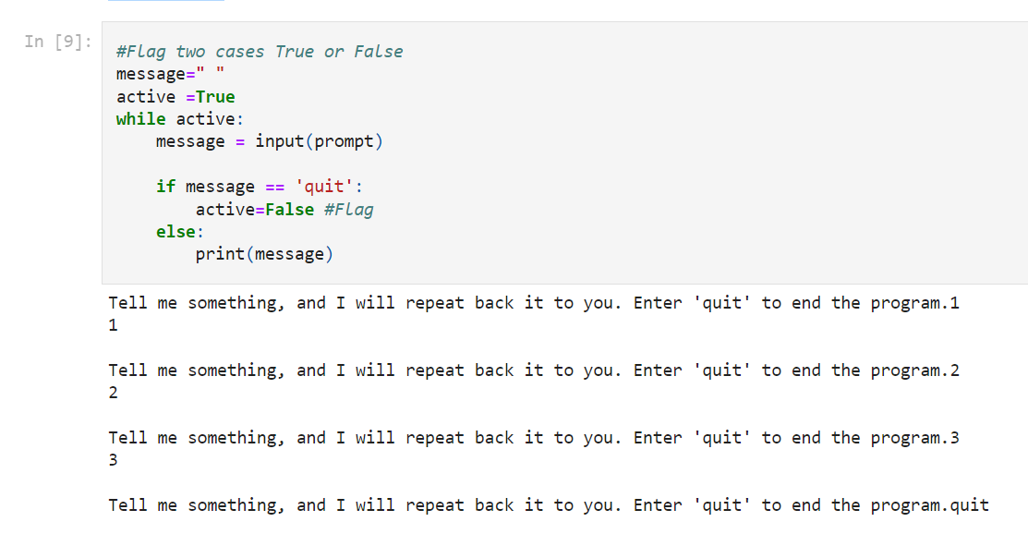
Examples of for loop

Slide 6
Break
Used to quit loop.
Can be for ‘for’ and ‘while’ loop.

Slide 7
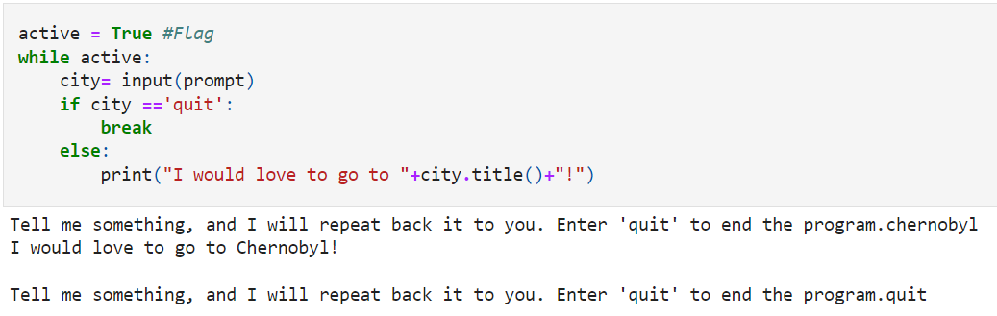
Break - can be for ‘while’ loop

Slide 8
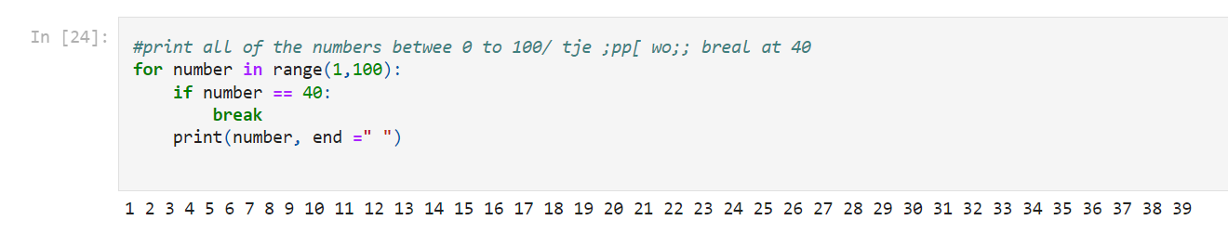
Break - can be for ‘for’ loop

